Slide 1



Capabilities Presentation

Slide 2


What We Do | Overview
Cassus Media | Digital Marketing Solutions® is a full-service marketing agency based in Altoona, PA. We provide in-house media production, managed marketing services, and basic web-related IT services (such as email and website functions) that help our clients do what they do.

Slide 3










What We Do | Services
Website Design
Web Maintenance
Graphic Design
Audio Production
Video Production
Social Management
Virtual Training
Email Marketing
SMS/Text Campaigns
Strategy & Consulting

Slide 4





Who We Serve | Sectors
Our current clientele consists of small businesses, to whom we offer tiered pricing plans, and state government agencies, to which we provide deliverables through various contracting vehicles.
Our government clients are served by providing deliverables based on specified guidelines and contractual requirements.
We offer full-service marketing to SMB clients and non-profits
through our 360° Marketing Program™ or à la carte as needed.

Slide 5
Our Services | Diving Deeper

Slide 6


Website Services | Design
A full view of our website portfolio can be viewed by visiting
cassusmedia.com/websites/portfolio/

Slide 7
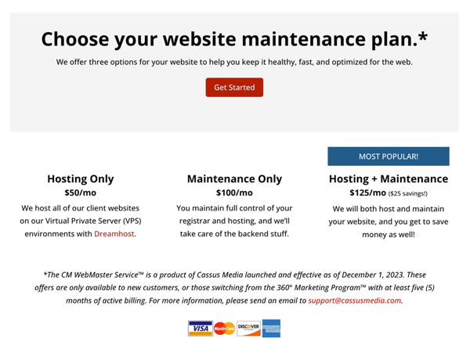

Website Services | Maintenance
To learn more about our CM WebMaster Service™, please visit
cassusmedia.com/webmaster-service/

Slide 8
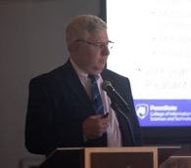
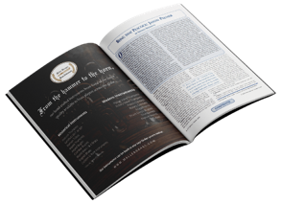





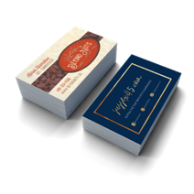

Graphic Design | Print & Digital
Graphic Design is a broad term for anything related to design a static visual layout. Such applications include social media images, photos, print products such as brochures, and advertising materials such as billboards and digital ads. See some of our work below.
Professional Photography
Print Publications
Social Media Graphics
Business Cards & Brochures
Posters & Billboards
Product Box Design

Slide 9
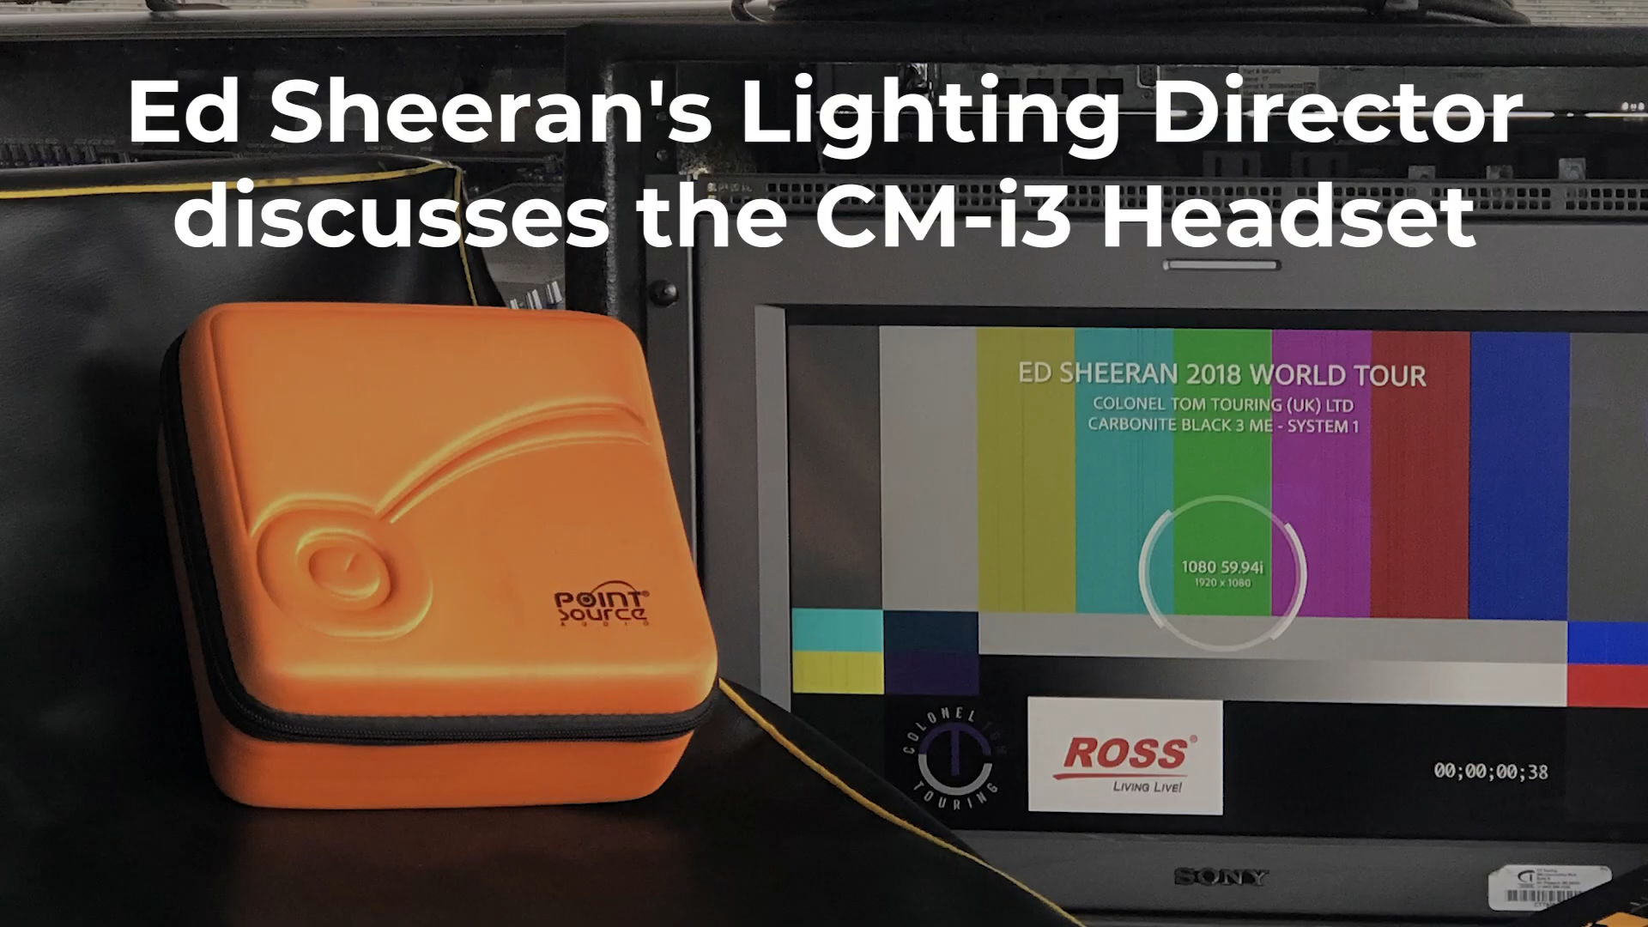

Audio Production | Sound & M/M
When it comes to audio production, we’ve had the pleasure of composing music for specific projects, mixing in effects, and mastering various projects for our clients over the years. We didn’t shoot the video ourselves, but we did the post-production, arranged the cover track of “Shape of You”, mixed and mastered the audio, and added closed captions for Matt’s voice for Point Source Audio in California in this example.

Slide 10
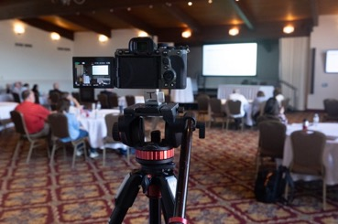
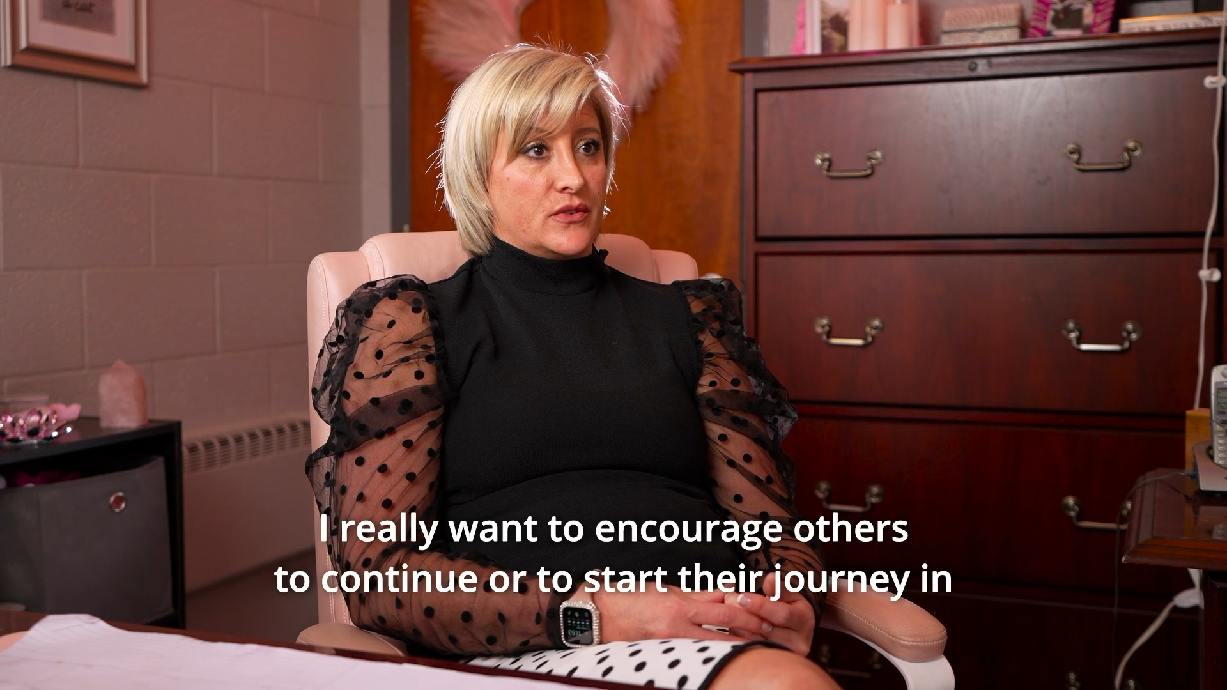

Video Production | On-Site & Post
We take great pride in working with top-notch videographers that help us achieve our clients’ goals. This example showcases an interview-style video for the Commonwealth of Pennsylvania’s Tobacco Recovery campaign in 2024.

Slide 11
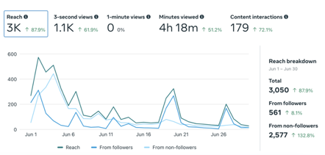
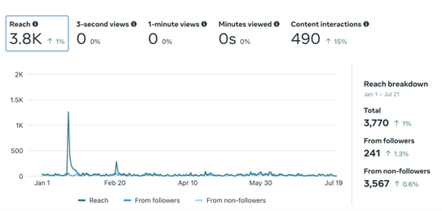

Social Media Management
Facebook. X. Instagram. LinkedIn. Pinterest. TikTok. These are all platforms that our clients use to promote their organization or brand, and we help them achieve their goals through organic and paid advertising campaigns.
Below, you’ll see some Facebook Insights examples of a small business client’s statistics, as well as a government-funded non-profit 501(c)(3) organic posting campaign.
June 2024 FB Performance Small Business Client
January-June 2024 FB Performance PA Government-Funded 501(c)(3)

Slide 12






Virtual Training | “Loom & Zoom”
We believe that teaching our clients is a more effective approach to consulting. That’s why we offer video training modules for specific questions or concerns.
We primarily offer virtual trainings with many of our clients by sending a Loom.com link, and these videos can be converted into course or training videos if need be.
Of course, we also meet with our clients via Zoom (or their preferred video chat software such as Teams, Google Meet, etc.) and spend time teaching them what they need to know so we can work together more easily.

Slide 13



Outreach Campaigns | Email & SMS
Through platforms like Mailchimp and Constant Contact, we are now able to reach our recipients through two very effective mediums under one digital roof:
E-mail and SMS texting.
We can reach our clients’ email lists with newsletters and announcements with the few clicks of a mouse, and track the efforts of our marketing strategy by seeing open rates, clickthrough rates, and more.
Alternatively (or simultaneously), we can send a text message and ping thousands of mobile phone users right in their pockets with a message,
image, and or link to achieve our clients’ marketing goals.
For this reason, Cassus Media is proud to be an official
…although we’ll work with our clients’ preferred platform. :)

Slide 14

Strategy & Consulting | Our Advice
We believe in the clients that we choose to work with.
We haven’t taken on every client, and we’ve had to part ways with a few.
We don’t know everything, but what we do know how to do, we do it well.
Quality is our goal, and accomplishing your organization’s goals is our mission.
Our leadership team is here to make sure that you accomplish the things that need to get done to help you further your organization in whatever way it measures its success. Whether you choose to bring us in as an attached marketing team, order services à la carte as needed, or simply ask us for our professional advice, we’ll do our best to help you figure out and solve the digital problems that you may have.
After all, we are Cassus Media | Digital Marketing Solutions®!

Slide 15
Wrapping It Up | About Us

Slide 16

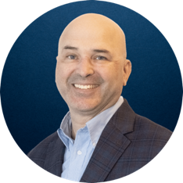
About Us | Leadership
Paul Cassarly is the co-owner and President & CEO of Cassus Media LLC. After attending Penn State University as a trumpet & music education major for two years, Paul decided to serve his country; he served in “The Commandant’s Own” U.S. Marine Drum & Bugle Corps as a 5512 soprano bugler until 2015.
He founded Cassus Media in 2017, and finished his Bachelors of Professional Studies from Berklee College of Music in 2019. He currently participates in multiple historical brass events, and is training to be a professional performer outside of his business duties under the direction of a renowned private teacher in Chicago.
Paul is the primary driver of Cassus Media’s internal operations, sales, and day-to-day tasks while learning how to delegate effectively in the face of rapid organizational growth from within.
Fun fact: Paul is a big fan of penguins, but figures that nobody would figure that out with Cassus Media’s branding endeavors.
Jeffrey Wilson is the Vice President and COO of Cassus Media LLC. As a seasoned entrepreneur and sales executive with 28 years of success and experience, Jeff began his career in the hard-driving advertising sales markets of Erie, PA, Washington, DC, and State College, PA.
Jeff’s startup Marketdrive Marketing created one of the first File Transfer Protocol applications in the television industry to allow advertisers to email broadcast-quality commercials across the internet, which in 2007 was ahead of the curve. Jeff worked with a network of digital information screens in the waiting areas of medical specialty offices which eventually sold to Accent Health, then again to Health Media Network. He now consults and invests in a few businesses outside of his own business ventures.
For the past 3 years, Jeff founded an innovative tax credit business facilitating the Pennsylvania Educational Improvement Tax Credit program through a network of private and public schools in Pennsylvania. Jeff lives in Bedford, PA with his wife and daughters. His favorite quote on entrepreneurship is from St. Augustine, “You plan a tower that will pierce the clouds? Lay first the foundation of humility.”

Slide 17


About Us | Certifications
NAICS CODES:
541613 (Marketing Consulting Services)
454110 (Electronic Shopping And Mail-Order Houses)
512110 (Motion Picture And Video Production)
512191 (Teleproduction And Other Postproduction Services)
512290 (Other Sound Recording Industries)
519130 (Internet, Broadcasting & Web Search Portals)
541870 (Advertising Material Distribution Services)
VENDOR INFORMATION:
DUNS: 105519530
UEI: RKGEVNTM9AL8
CAGE: 9AKZ7
PA VENDOR (NEW): 557274
PA VENDOR (Old): 549873
MD VSBE CERTIFICATION #: VB24-062963
MD VET VERIFICATION #: RKGEVNTM9AL8

Slide 18
About Us | Contact Information
Paul Cassarly
Mobile: (814) 934-1456
Email: pcassarly@cassusmedia.com
Jeffrey Wilson
Mobile: (814) 283-4338
Email: jwilson@cassusmedia.com
COMPANY INFO
Call/Text: (910) 377-7337
Email: support@cassusmedia.com
Visit us in person (M-F 8am—5pm):
3900 Industrial Park Dr, Suite 6
Altoona, PA 16602

Slide 19
Thanks for listening!

